Slide 1
Data Visualization Using MatPlotLib
Etana Disasa
College of Computer & Information Sciences
Regis University

Slide 2
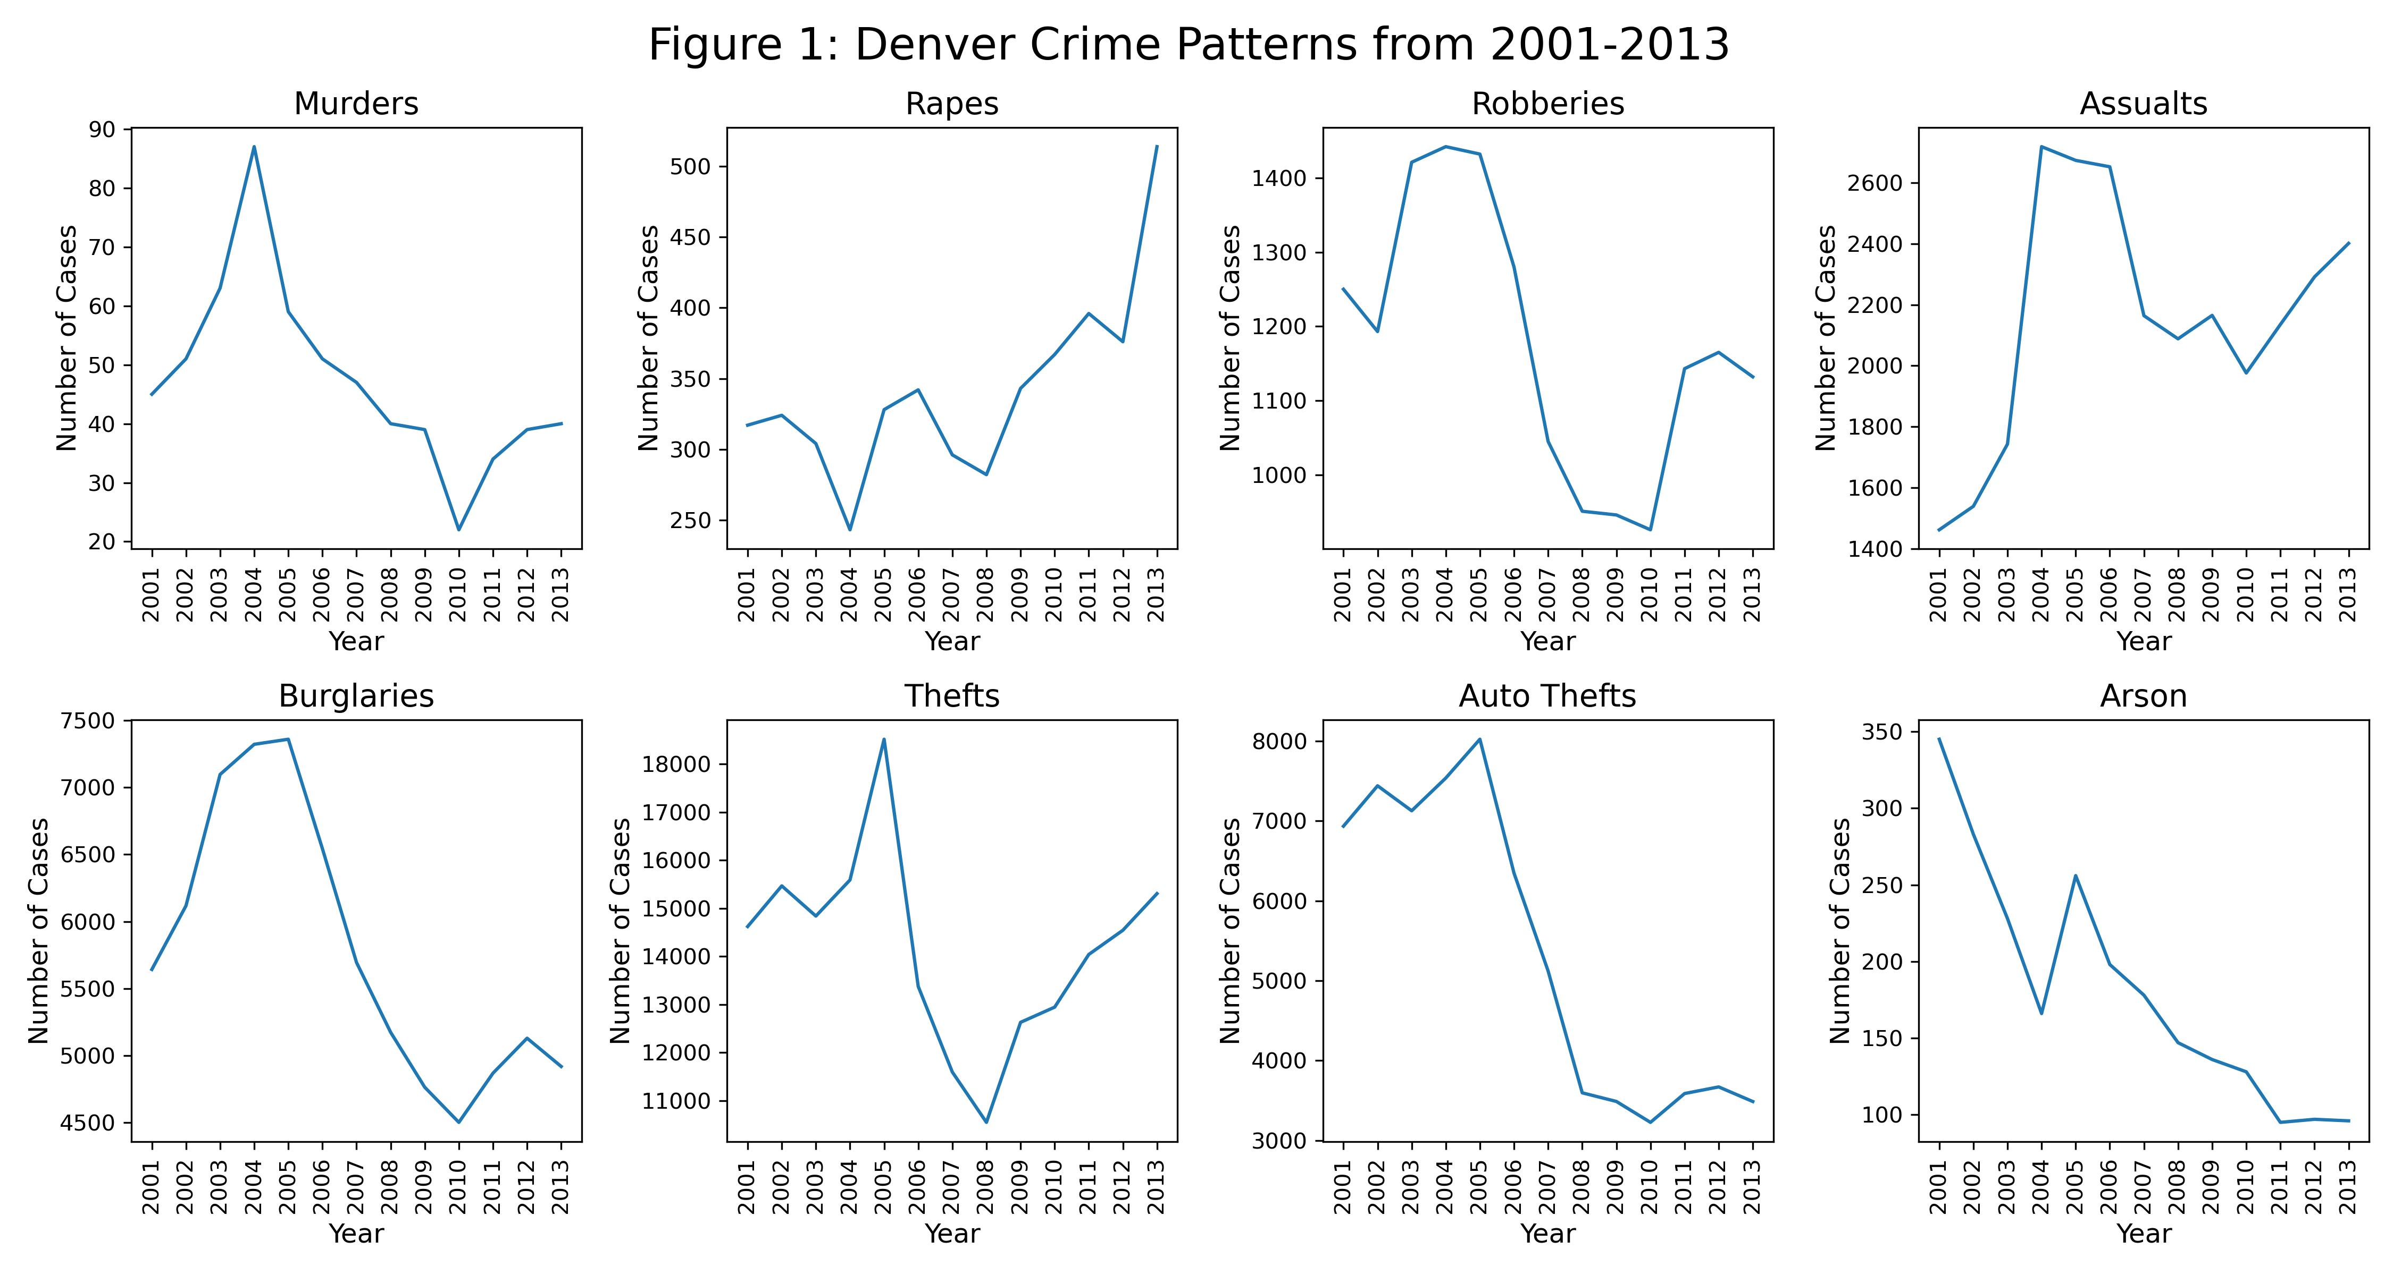
Denver Crime Patterns from 2001-2013
Figure 1 displays subplots of eight different crime patterns from 2001 to 2013.
Overall murder, burglaries, robberies, auto thefts and arson are showing decreasing pattern.
Nevertheless, assaults and rapes are are increasing.
As a matter of fact, rape cases have almost doubled in 2013 compared to 2001.
Arson and auto thefts have gone significantly.
Another important element is that, in the year 2004-2005 time frame, Denver had experienced a huge spike in all crime categories.

Slide 3
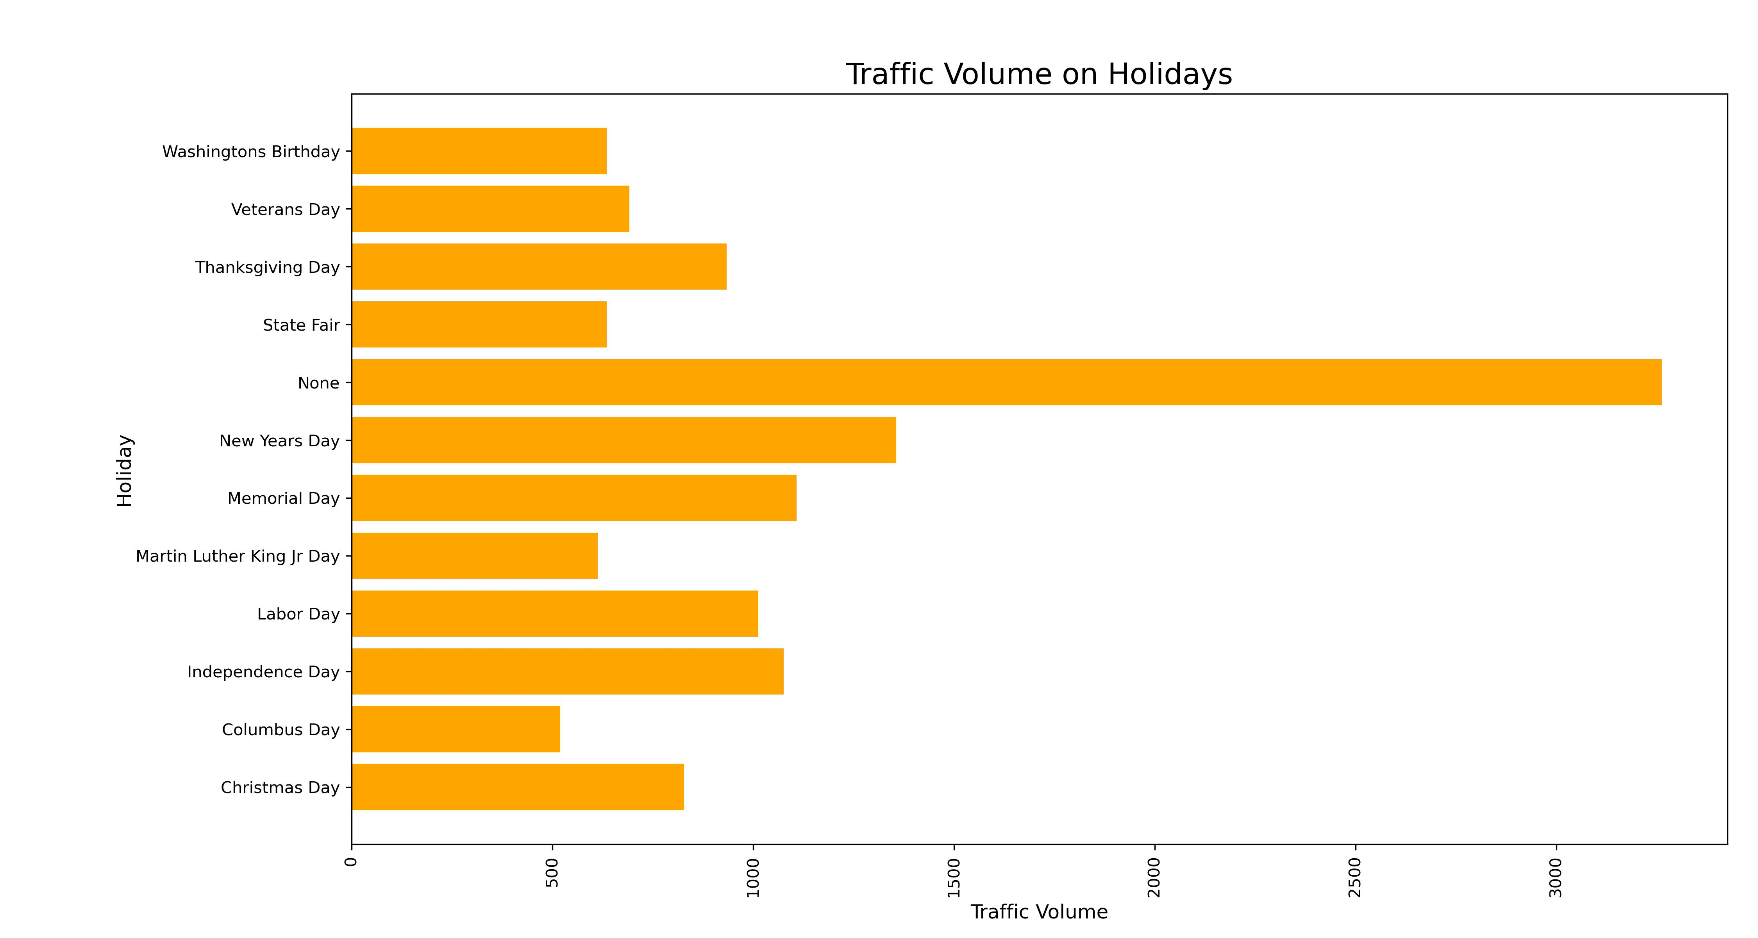
Traffic Volume on Holidays
This data shows that even though traffic volumes show significant slow on holidays, days such as New Years day, Memorial day and independence day still manage to bring drivers on the road.

Slide 4
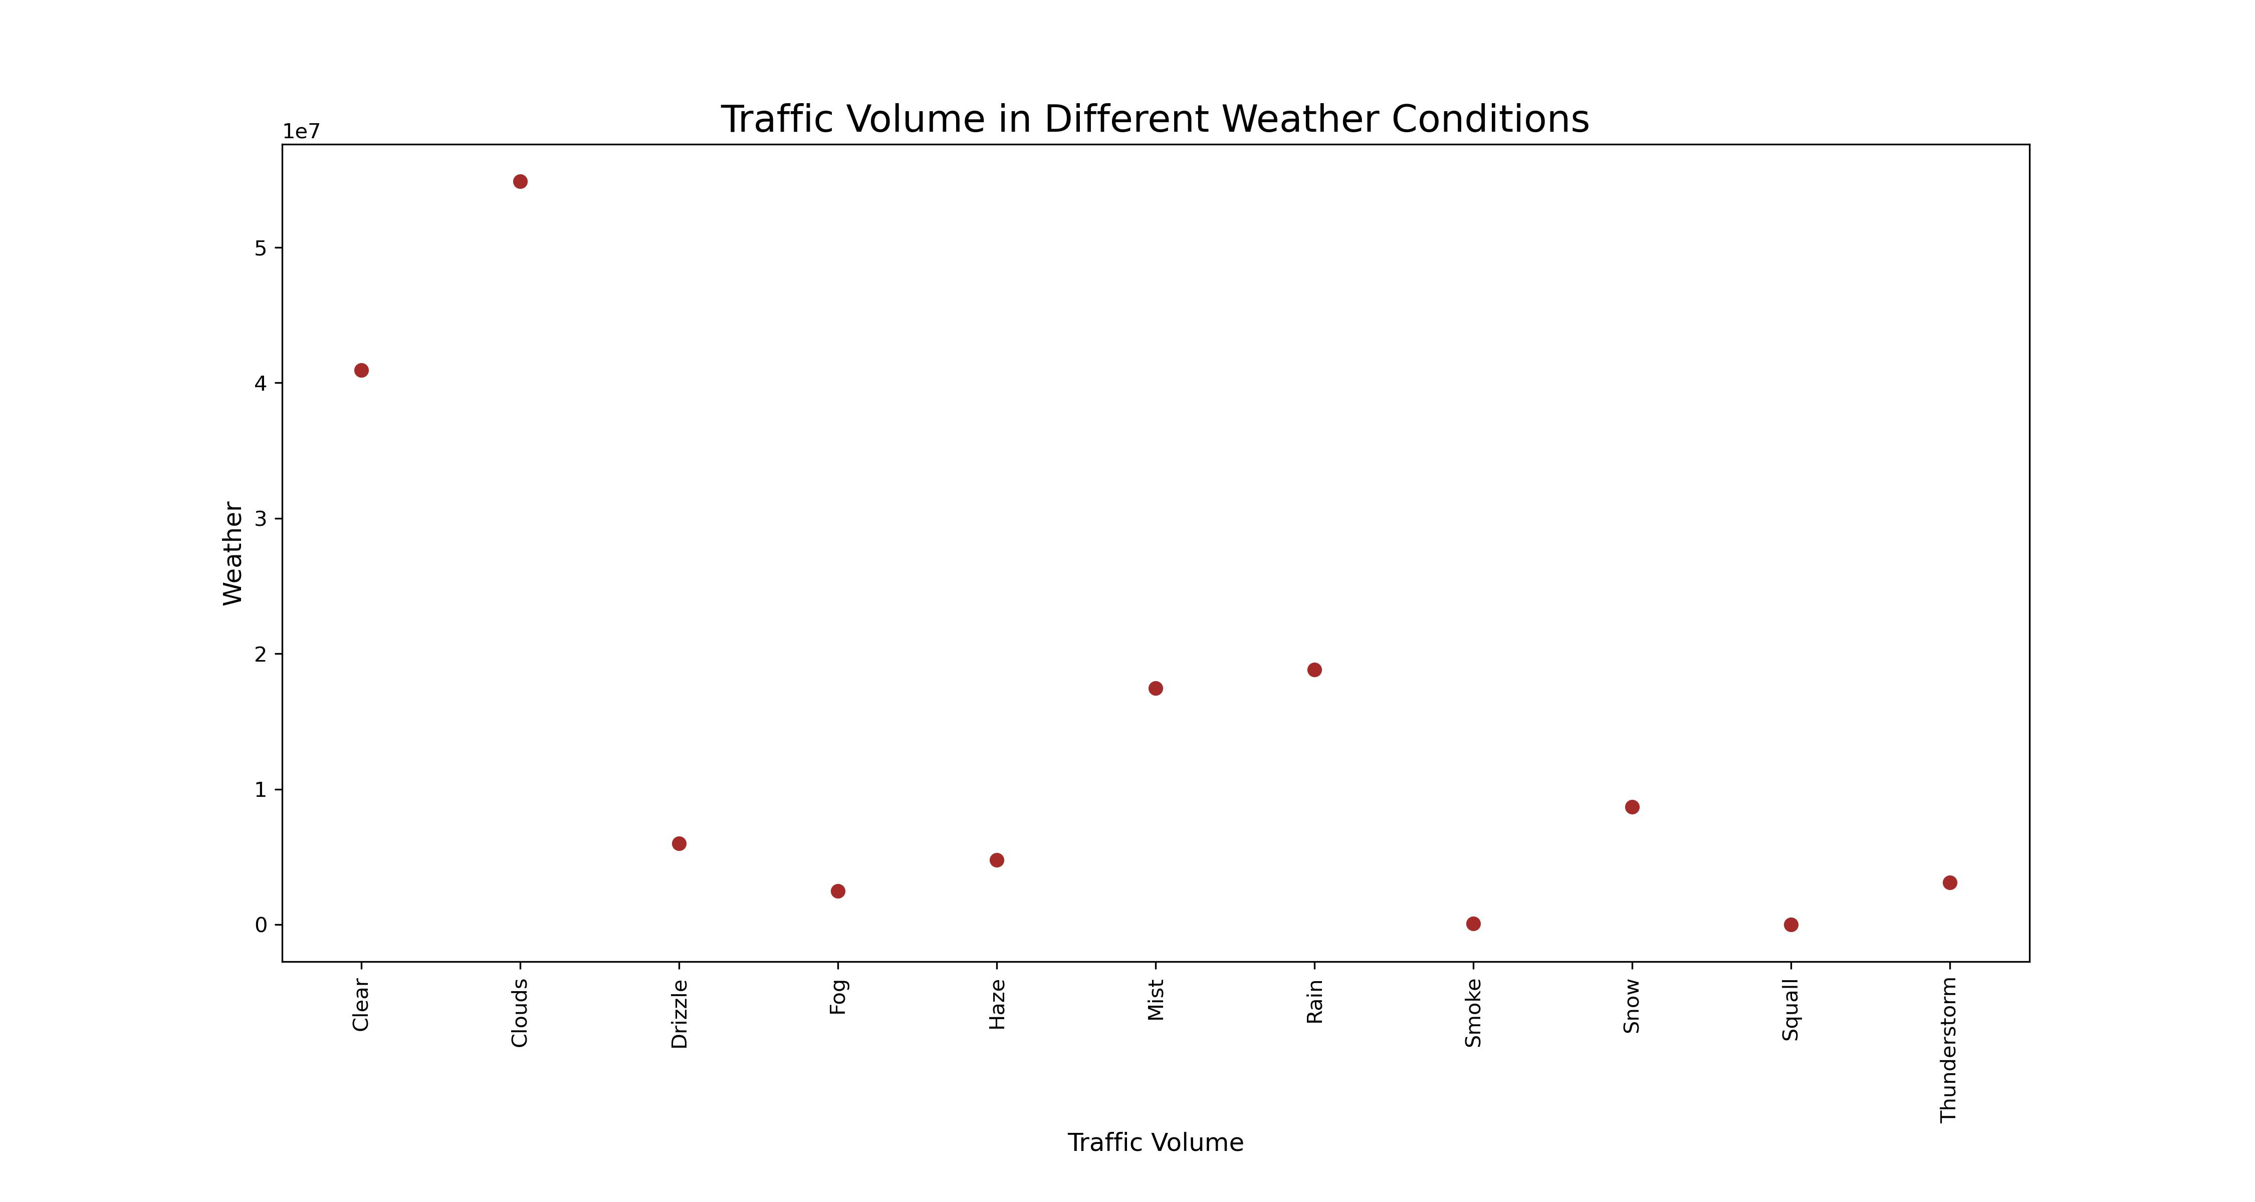
Traffic Volume in Different Weather Conditions
After further examining the dataset, it is evident that cloudy days appear to bring more drivers.
Surprisingly enough, more drivers were on the road in cloudy days than clear skies.
Squall weather and smoke conditions appear to keep drivers off the road.
Rain, mist and snow appear to slow traffic volume. However, not more than drizzle, fog, haze and thunderstorm weather conditions.

Slide 5
Conclusion
The first dataset indicated that the crime incident for arson and auto theft has decreased. However, the spike in assault and rape cases is alarming.
In 2004-2005 time frame, Denver witnessed a significant spike in all crime categories.
Second dataset indicates some holidays such as New Years Day appear to draw more traffic on the road. Still, holidays appear to slow traffic flow.
Furthermore, cloudy days tend to bring more drivers on the road higher than days with clear skies.

